Slide 1

FreeSpirit – A Celebration Of Sharing Happiness

Slide 2








Agenda
Introduction
Project Plan
Range Of Solutions
Revenue Model
Product & features
Future Vision
Value Proposition
Q&A

Slide 3
Introduction
FreeSpirit is a pioneering opportunity to bring people together like never imagined before, by expanding a proven & classic concept, to join forces with modern technology platforms.
It empowers FL3 business owners to offer their services to a completely new range of customers in cost effective & accelerated manner, by allowing them to expand in fast growing world of netizens.
It will launch state of the art mobile & web application for both FL3 & FL4 consumers, having a host of features that are over & beyond anyone in current landscape has to offer.
While this solution resolves chronic challenges faced by FL3 businesses, it also open up innovative prospects for FL4 consumers to connect not just with friends & family, but also to make new friends having shared interests & thought process.
The idea is simple but so powerful, having potential to change hospitality business forever.
And we are just warming up !

Slide 4
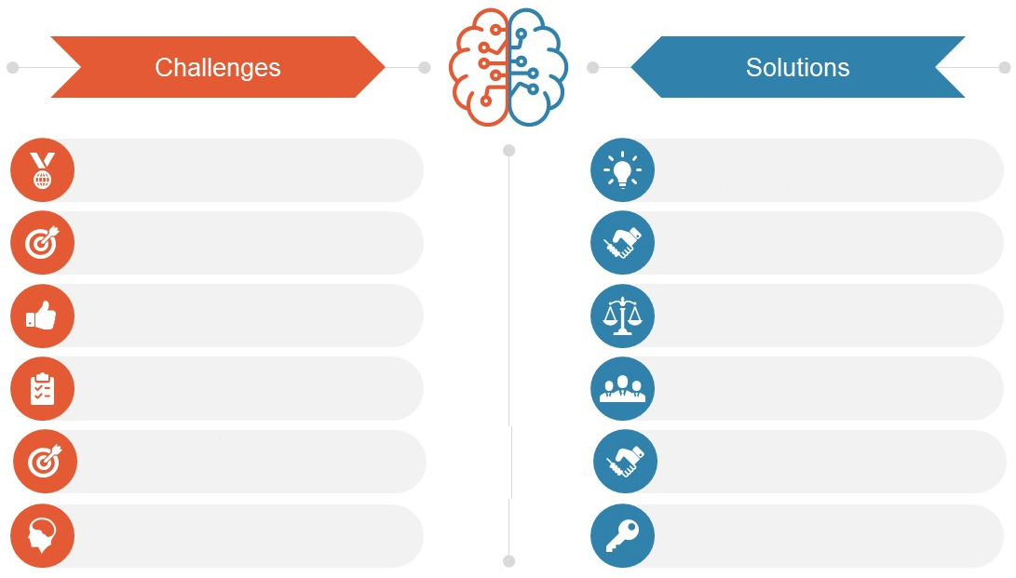
Range of Solutions
Lack of options to share or gift a drink to friends or family
Unique & unmatched opportunity
to share/offer drink to anyone, anywhere
No socializing platforms in FL3 premises
Innovative technology driven platform for B2C & C2C interaction
Low margins of operation when utilizing traditional delivery models
Higher benefits & financial control with reduced expenses
No avenues for cost effective event arrangement or promotion
Economical means of social event
organization & rapid marketing
Obligation of menu costing without future benefits
Use based costing, with exciting offers & guaranteed cashback
No tangible advantages of higher spend & lockdown sensitivities
More value for money & standardization of health & wellness

Slide 5
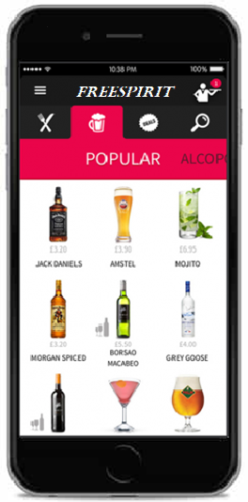








Product & Features
Gift a drink
Gift or share a drink of choice to your beloved ones e.g. Corporates, Family & Friends & colleagues
Eat Now, Pay Later
Service for the select privileged customers
Offer a drink
Offer service will be availed at merchant establishment with other groups or individuals
Live Streaming
To virtually share special moments with the dear ones
Events & Gaming
Promote corporate events, interactive games for in-house patrons
Purchase a drink
Instant cashback facility for regular customers who avail restaurant services
Payments & Point Wallet
Express true feeling of sharing & gifting with points instead of money
Food Delivery
Break the dependency of service aggregators, with reduced expenses

Slide 6
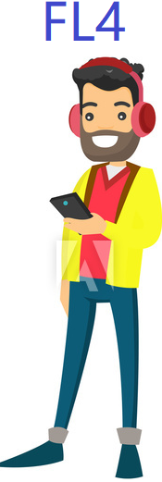
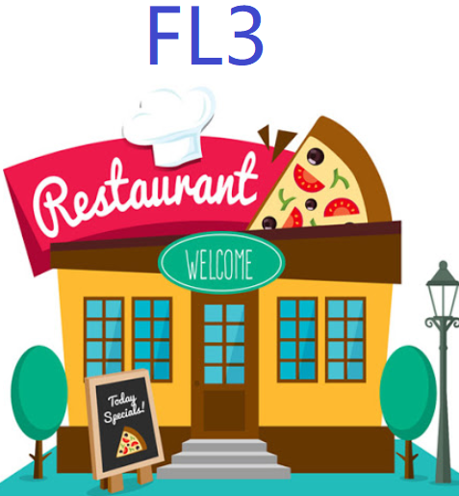
Value Proposition
Offer Event
Packages
Interactive Games & Event Hosting
Mingling via Games
& Chat
Socialize
By Offering
A Drink
Economical
Delivery
Increased reach through acceptance & branding
Unique interactive platform for FL3
Reduced delivery costs
Increased
Footfall
Top standards for wellness & hygiene
Socializing opportunity for socially distant
More value for money through cashback offers
Gift / Share
A Drink
Anyone
Anywhere
Anytime
Off
Season
Boost
New
Customer
Base
Have Drink,
& get
Cashback
Multi City
Platform
Corporate Events & Flexible Packages
Range
Of FL3 to choose
Occasional
Promotion
Higher Customer
Retention
Register
For Local
Events
Cost Effective
Marketing
Cashback
& Exciting
Offers

Slide 7
Project Plan – 6 Waves
Wave 06
October 2023
Expand in existing 10 Cities & explore additional scope
Target 3600 FL3 & 3.6 Lacs FL4 Customers in Each City
3600 FL3
36Lacs FL4
3000 FL3
30 Lacs FL4
Wave 05
April 2023
Expand in existing 10 Cities & explore additional scope
Target 3000 FL3 & 3 Lacs FL4 Customers in Each City
Wave 04
October 2022
Expand in existing 10 Cities & explore additional scope
Target 2400 FL3 & 2.4 Lacs FL4 Customers in Each City
2400 FL3
24 Lacs FL4
1800 FL3
18 Lacs FL4
Wave 03
April 2022
Expand in existing 10 Cities & explore additional scope
Target 1800 FL3 & 1.8 Lacs FL4 Customers in Each City
Wave 02
October 2021
Expand in existing 10 Cities & explore additional scope
Target 1200 FL3 & 1.2 L acs FL4 Customers in Each City
1200 FL3
12Lacs FL4
Wave 01
April 2021
Launch in 10 Cities
Target 600 FL3 & 60 thousand FL4 Customers in Each City
Initial Phase
Company Registration – July 2020 - Complete
Launch App – October 2020
Copyright – October 2020

Slide 8
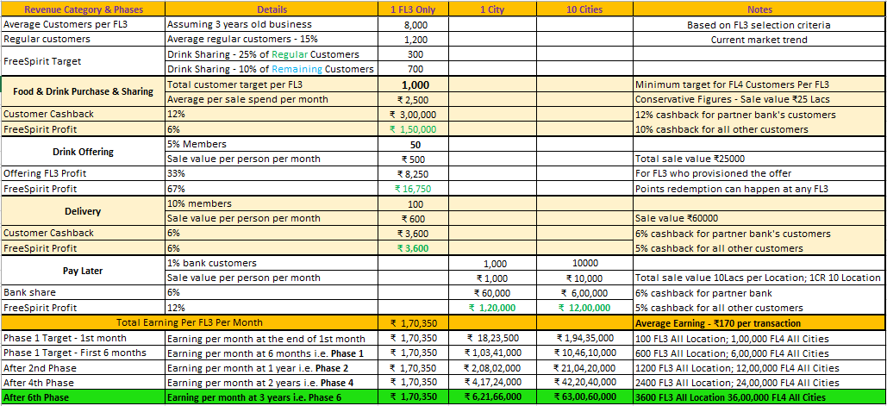
Revenue Model

Slide 9
Future Vision
FreeSpirit Hangout for close friends & family and personalized theme based offers, events & alerting
Multi-tier membership with range of features as remote connect, year-end party, hotel booking etc.
Patent, Sponsored Event Services, E-KYC
Pricing diversification, Pan-India launch, Integration with other popular apps
Data science & analytics, Supply-chain services
Streaming services, Overseas launch, Integration with other apps
FL3 appraisal & customer rating, FLXC support

Slide 10






Question & Answers

